Slide 1
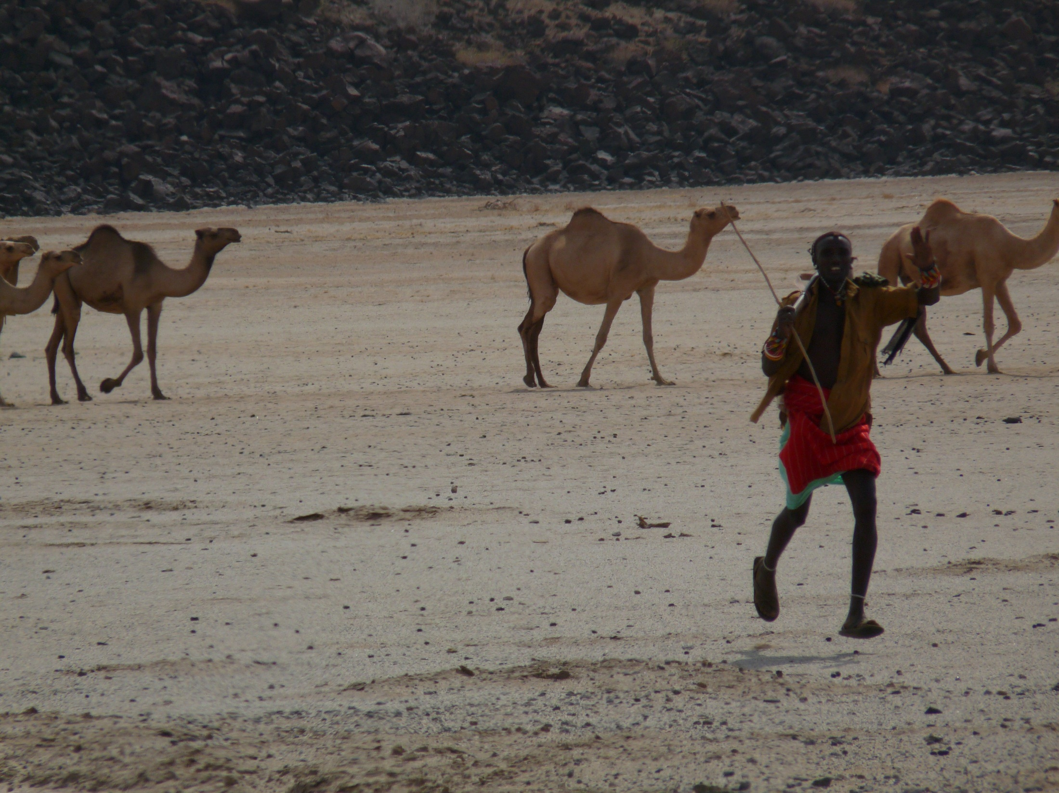

Assessing the Societal Impacts of Intervention Portfolios
Prof. Chris Barrett
Cornell University
Mastercard Foundation PANA Seminar Series
June 15, 2026

Slide 2


Why impact assessment?
Society faces many challenges.
Many^{many} candidate solutions exist.
How can impact-oriented groups make, scale, and sustain advances on the challenges they tackle?

Slide 3
Why impact assessment?
Lessons from my >30 years doing this…
From the outset:
Pre-specify and (groupwise) rank stakeholder objectives
Rigorously identify what works (best)
Plan for scaling, adapting and sustaining gains
Illustrate with 4 major research projects in rural Africa.

Slide 4

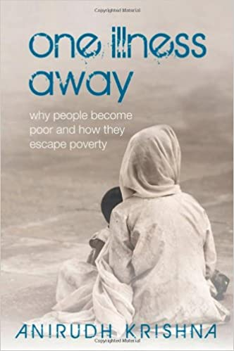
My obsession:
Risk-based poverty traps
Marginalized populations are defined not only by the depth and prevalence of poverty and other ills but equally by deprivations’ persistence. Uninsured risk exposure is a key cause.
The possibility of risk-based poverty traps puts a premium on risk reduction and risk transfer tools.
4 projects tackling risk-based poverty traps illustrate key impact assessment issues.

Slide 5
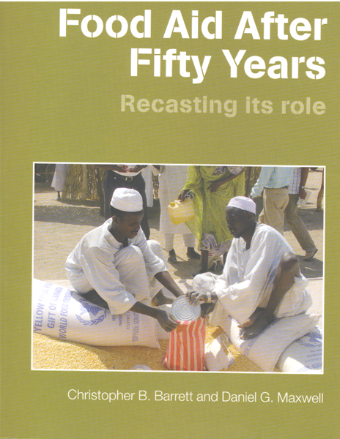
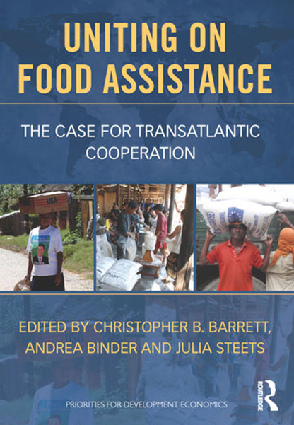
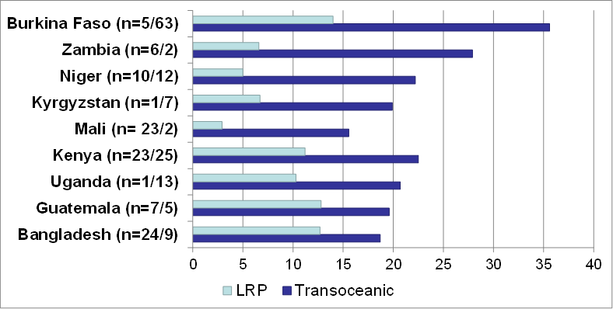
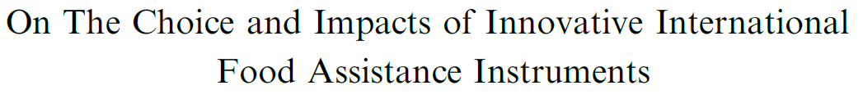
`
Fixing food aid
A massive, valuable resource, inefficiently and ineffectively used, cynically manipulated.
20 yrs’ work on evidence-based food aid reform. Directly test mythical claims – food aid causes dependency, ruins markets and hurts LIC farmers, helps HIC farmers, etc. – to push policy towards flexibility to fit response to context.
LRP Learning Alliance (6 NGOs + Cornell) tested key policy hypotheses, studying what worked/ scaled across a portfolio of countries/interventions. Had big policy impacts.
Mean Δ: 13.4 weeks (59%)

Slide 6
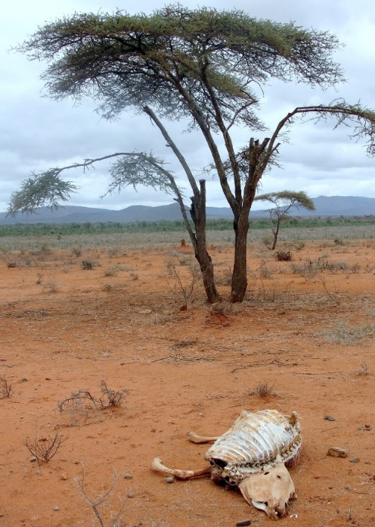

Risk transfer among east African pastoralists
Poverty traps in Kenya/Ethiopia rangelands due to catastrophic herd loss risk from major droughts.
So Cornell + partners designed and launched index-based livestock insurance (IBLI) in 2010. Early use of satellite remote sensing to price risk to transfer African drought risk into global capital markets.
Very favorable impacts across multiple metrics and time scales (immediate to 10-year), with policy impacts across Africa. Now in 4 countries, >5 mn insured pastoralists, plus gov’t sovereign risk.

Slide 7
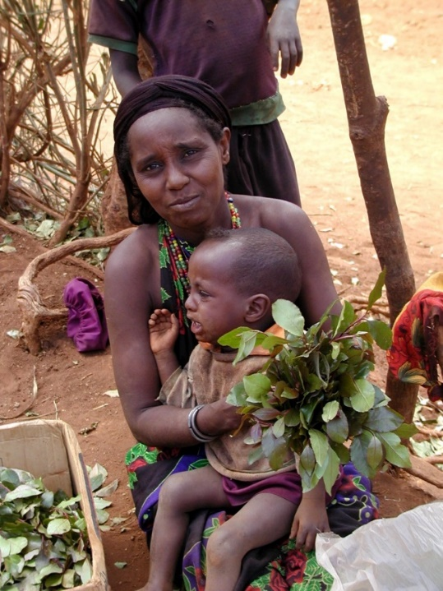
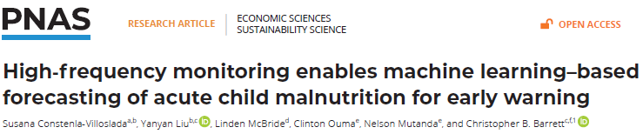
Anticipatory transfers to avert child malnutrition
Develop early warning/targeting tools to enable low-cost, fast, high-impact response to shocks.
Child GAM forecasting in Kenya w/NDMA:
NDMA pilot uses forecasts to trigger anticipatory mobile money transfers to mothers based on forecast triggers. ~$42/month reduces GAM prevalence ~9pp (vs. ~13 pp. synthetic control)

Slide 8
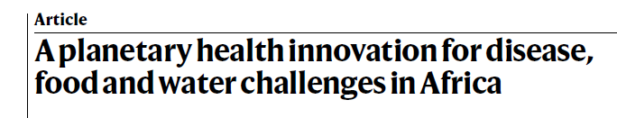
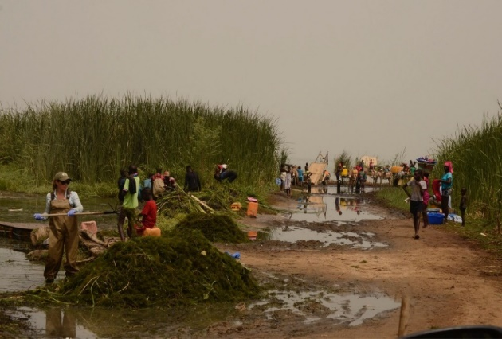
Reducing infectious disease risk
Schistosomiasis/bilharzia infects >240mn globally. Especially harmful for children/women. MDA usual response, but high reinfection rates.
Multi-pronged approach:
(1) Clear water access points of snails’ preferred habitat, Cerato. Make compost, livestock feed.
(2) Rice-fish co-culture to reduce snails and boost crop productivity.
(3) Livestock vaccines to reduce recontamination, hybridization.

Slide 9

What lessons learned on IA?

Slide 10
Pre-specify stakeholder objectives
Identify who are key stakeholders to make this work? funders, policymakers, beneficiaries, intermediaries.
What are their primary/secondary objectives?
How to measure progress against each of those objectives? If many, groupwise rank them. Look for tradeoffs/synergies.
Where possible, pose as testable hypotheses.
Do before designing intervention and MEL methods.
Iterate as new stakeholders emerge.

Slide 11
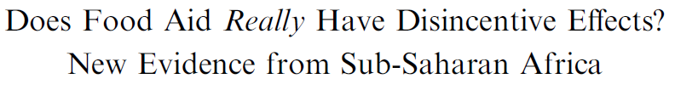
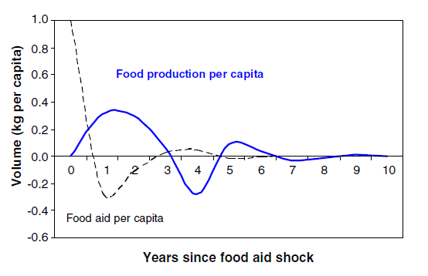
Rigorously identify what works (best)
Correlation ≠ causality. Design IA to isolate causal effects on the pre-specified objectives.
Use best feasible/appropriate method. Sometimes that’s randomization; sometimes it’s not!
Lots of experimental (RCT, randomized encouragement), quasi-experimental (discontinuity, synthetic control, selection, IV) and other methods.
Some are easier/harder in different context, but none intrinsically superior in scientific terms. Key is ‘conditional independence’.

Slide 12
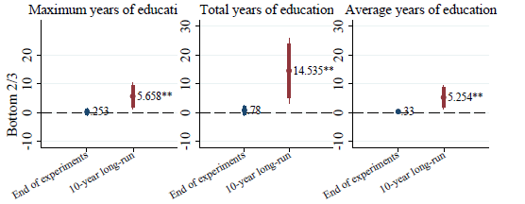
Rigorously identify what works (best)
Will do something. So test what works best, not just what works! Thus A/B testing not just zero nulls. Especially in benefit/cost terms. Portfolios work very well for this.
(IBLI vs. cash transfers)
Anticipate heterogeneous effects and design MEL to identify how impacts vary by condition/subpopulation.
Ensure capability to follow up and test longer-run impacts.
Effects may not last; people, markets, institutions adjust.

Slide 13

Rigorously identify what works (best)
6. Monitor for unintended consequences. IBLI examples: agent overselling, rangelands degradation.
7. Track all parts of the innovation bundle. For IBLI,
extension design, agent incentives. Senegal design.
8. Qual-quant integration to explain the data and to
tell the story.
9. Replication to synthesize evidence.
Ex: LRP Learning Alliance impacts due to aggregation. Pooled data from 9 countries, 5 agencies, rigorous controls, clear hypotheses underpinned future policymaking/programming.

Slide 14
Plan for scaling, adapting and sustaining gains
Researcher-led trials can establish small-scale efficacy. But neither scalable nor sustainable. Must know effectiveness in less controlled conditions. Plus, need local partners to sustain financially and institutionally.
Key: Need local partners buy in from the outset, in MEL design, interpreting findings, adaptation to changing contexts.
IBLI: local partners; adapt to differing context in Ethiopia; adjust payout timing/purpose.
NDMA: drive how to integrate ML forecasts into operations
Schisto: local partners work to identify how to induce cerato removal, rice-fish co-culture.

Slide 15
Cross-cutting issues
1. Commit to FAIR (Findable, Accesible, Interoperable, Reusable) data principles. Enables others to tap data and ask/ answer new, important questions. Analytical multiplier!
2. Third-party, honest broker for aggregation/synthesis. Emphasize pre-competitive benefits to grantees.
3. Cultivate new technical and leadership talent. Succession planning from the outset.
4. Foster a culture that embraces failures and challenges. Null results and obstacles are valuable!

Slide 16
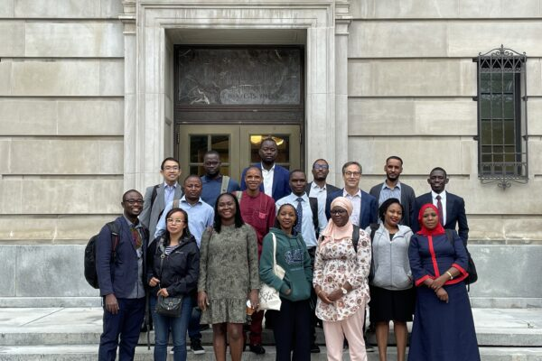
How can we help?
Tackling big challenges requires a commitment to learn.
- What do stakeholders want/need?
- What works best under what conditions?
- How to scale, adapt and sustain?
Cornell/CIDER and our community of STARS Fellows can help.
Thank you for your time,
attention and efforts!

